Slide 1






Grocery Store
Management
Everyday Shopping Destination
@SubbuAvula

Slide 2





About me
•I come from a Computer Science background, which has given me exposure to both technical •skills and business understanding. This combination naturally led me to develop a strong interest in Data Analysis.
B.Tech
Bharath University
https://www.linkedin.com/in/a-munisubramanyam-939953255/
https://github.com/Subbu85307

Slide 3




Agenda
Objective of the Project
ER Diagramand schema explanation
Key analysis questions (usecases)
SQLquery results with Images
Challenges
Conclusion

Slide 4


Objective of this project
•The main goals of this SQL project are:
•To design and implement a relational database for a grocery store.
•To retrieve and manipulate data using SQL queries
•To perform data analysis for business insights such as top customers, best-selling products, and revenue trends.
•To practice using joins, aggregations, subqueries, and filtering techniquesniques.

Slide 5
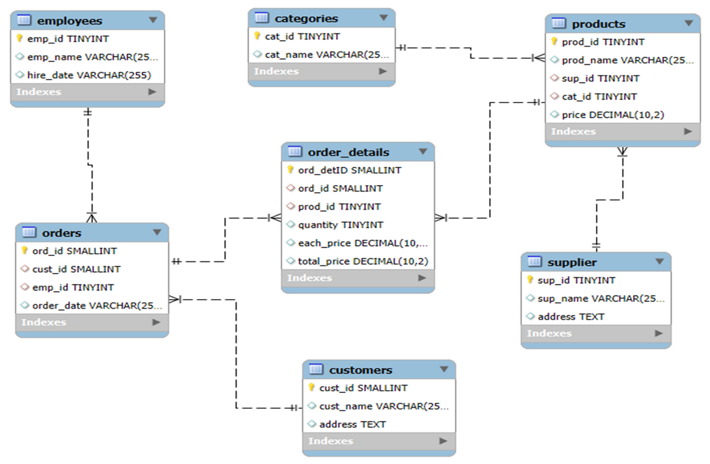
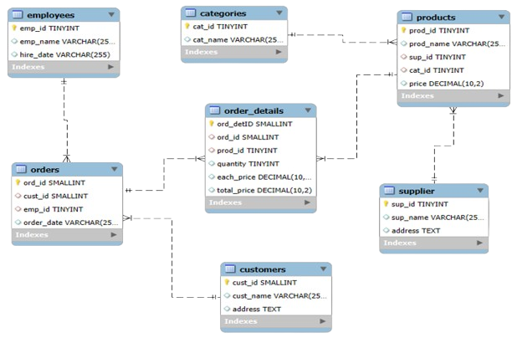

ER Diagram

Slide 6


Analysis questions
1. Customer Insights
1
2. Product Performance
3. Sales and Order Trends
4. Supplier Contribution
5. Employee Performance

Slide 7

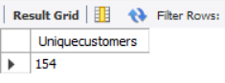


SQL Query Results
1.customer insights
-- a.How many unique customers have placed orders?

Slide 8
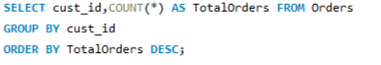

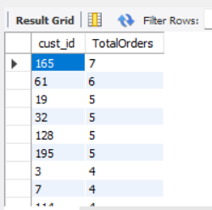

SQL Query Results
1.customer insights
--b.Which customers have placed the highest number of orders?

Slide 9
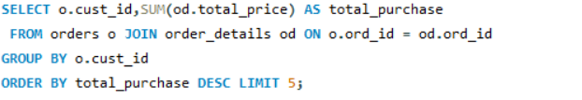
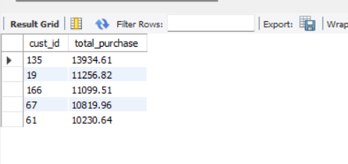
SQL Query Results
1.customer insights
--c.Who are the top 5 customers by total purchase amount?

Slide 10
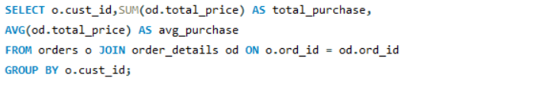
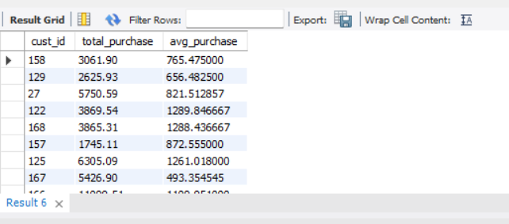

SQL Query Results
1.customer insights
--d.What is the total and average purchase value per customer?

Slide 11
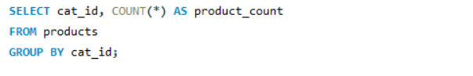

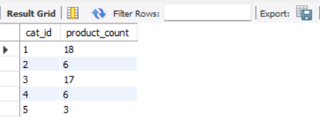
SQL Query Results
2.Product Performance
-- a.How many products exist in each category?

Slide 12
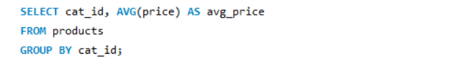
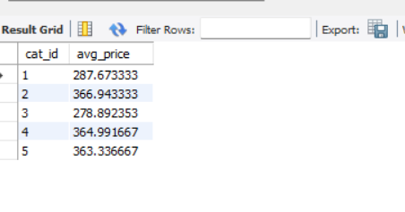

SQL Query Results
2.Product Performance
--b.What is the average price of products by category?

Slide 13
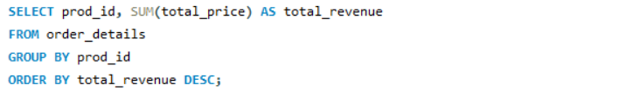
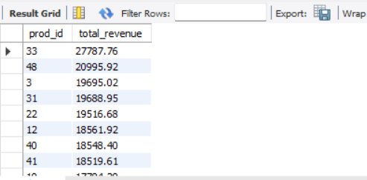

SQL Query Results
2.Product Performance
-- c. What is the total revenue generated by each product?

Slide 14

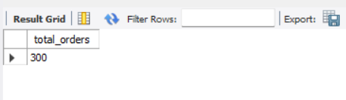
SQL Query Results
3. Sales and Order Trends
-- a. How many orders have been placed in total?

Slide 15
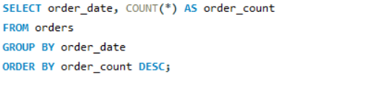
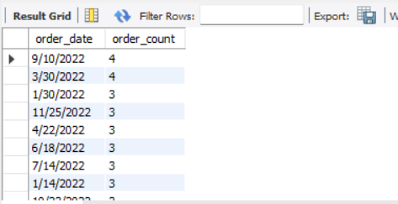

SQL Query Results
3. Sales and Order Trends
-- b. On which dates were the most orders placed?

Slide 16
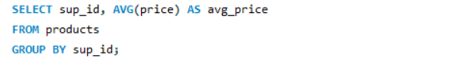

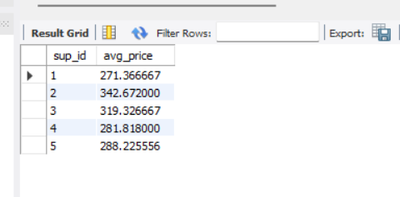
SQL Query Results
3. Sales and Order Trends
-- c. What is the average price of products from each supplier?

Slide 17
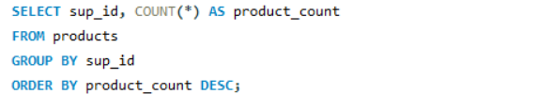

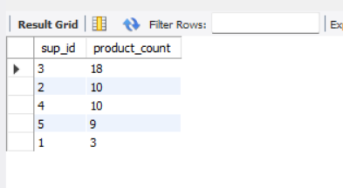
SQL Query Results
4️. Supplier Contribution
-- a. Which supplier provides the most products?

Slide 18
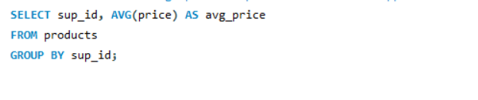

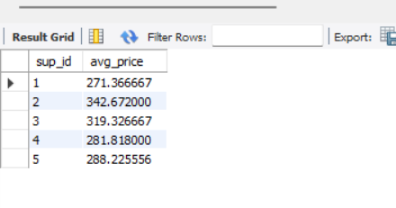
SQL Query Results
4️. Supplier Contribution
-- b. What is the average price of products from each supplier?

Slide 19
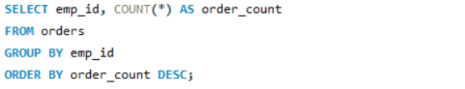

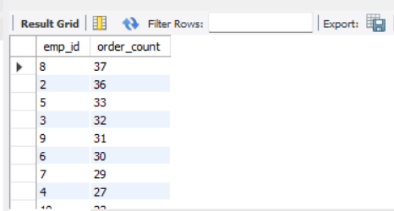
SQL Query Results
5️. Employee Performance
-- a. Which employees have handled the most orders?

Slide 20
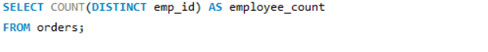
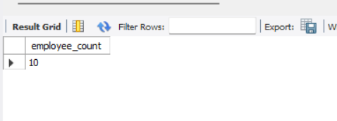

SQL Query Results
5️. Employee Performance
-- b. How many employees have processed orders?

Slide 21
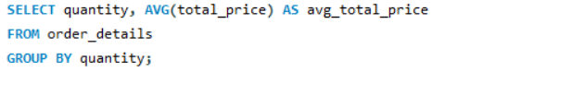
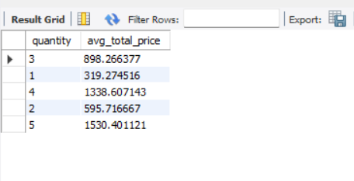
SQL Query Results
6️. Order Details Deep Dive
-- a. What is the relationship between quantity ordered and
total price?

Slide 22
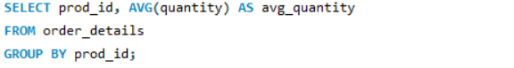
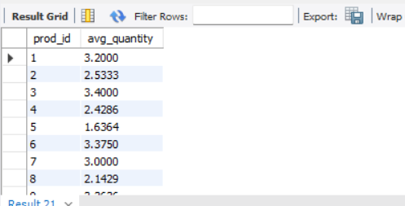

SQL Query Results
6️. Order Details Deep Dive
-- b. What is the average quantity ordered per product?

Slide 23


Challenges
Understanding table relationships and applying correct joins.
Ensuring data consistency with foreign key constraints
Handling aggregation across joined tables.
Extracting time-based trends from date data (especially if in VARCHAR format).

Slide 24



Conclusion
By implementing this SQL project for data management and analysis, this project delivers meaningful insights into sales, customers, and operations, supporting smarter and data-driven decision-making.

Slide 25


Thank u

